Slide 1
IHS and Human Centered Design
HCD and HIT Modernization: Engagement of End Users in Health IT Modernization through Human-Centered Design
S28
Terry Cullen
Regenstrief Institute, Indiana University
Twitter: #AMIA2019

Slide 2
Disclosure
I and my spouse/partner have no relevant relationships with commercial interests to disclose.

Slide 3
Learning Objectives
After participating in this session the learner should be better able to:
Understand the high-level goals of the Indian Health Services (IHS) Modernization Project
Understand how Human-Centered Design (HCD) was applied in the high-level approach to the IHS Modernization Project
Recognize the need for cultural sensitivity
Articulate the value of an HCD approach in clinical informatics projects

Slide 4
Lessons Learned Working Cross-culturally
What Matters
Integrating cultural experts in your team
Learning about the cultural
SHOWING UP
Ensuring that the voice of the end user is heard
Humility

Slide 5
Project Purpose and Objectives
“IHS must create and execute a strategy to modernize its EHR system and the IT systems necessary to support it”*
Context
IHS serves 2.6 million American Indian and Alaska Native people Underfunding of HIT within IHS has hindered the organization’s ability to keep pace with user requirements and market solutions The VA’s decision to migrate away from VistA is a catalyst for IHS to investigate EHR alternatives IHS must act swiftly to modernize its aging HIT system
Project Objectives
Leverage internal and external expertise to: Evaluate the current state of HIT across the I/T/U Identify and evaluate alternative EHR solutions for HIT modernization Produce recommendations regarding people, process and technology Define a roadmap to implement these recommendations
*As stated in the Background Statement of the IHS HIT Modernization Research Project RFQ from August 2018
5
Notes:
Terry to address the drivers to starting this project on this slide

Slide 6
Project Guiding Principles
The Modernization Project provides a comprehensive assessment of the people, processes, and technology that comprise the existing IHS HIT system, the Resource and Patient Management System (RPMS)
The team was committed to the following principles:
Honor and respect tribal communities and stakeholders
Be people-centered
Utilize impactful, community-serving processes
Be data-driven in all decision making
PEOPLE
PROCESS
HIT
TECHNOLOGY

Slide 7



Project Approach
Using a Human Centered Design methodology, the project team developed and implemented the following three-pronged approach to better understand the current state of the IHS HIT systems and the unique needs of the users that it serves.
Understand
User Perspectives / Needs
Understand
System Capabilities
Determine Options
& Best Practices
I/T/U Site Visits
Legacy System Evaluation
Literature Research
Virtual Sessions
Technical Advisory Commission (TAC)
Data Calls
Analysis of Alternatives
Community of Practice (CoP) Plan
Capability Maturity Model & Toolkit
Roadmap
Notes:
Focus on the current situation and Gaps
Goals of the qualitative / human-centered methods

Slide 8

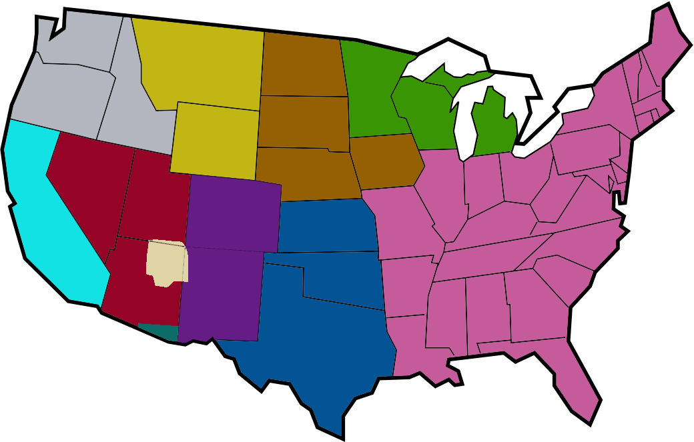
Breadth of Data Collected
25 Site/ Facility Visits to engage with 450 site personnel
13 Virtual focus sessions with members of national workgroups
5 Conferences, national and Tribal
1,877 Responses from 240 I/T/U facilities through a Data Call and emails from site personnel
BILLINGS AREA
Missoula Urban Indian Health Center
Northern Cheyenne Service Unit
GREAT PLAINS AREA
Pine Ridge Service Unit
Rapid City Service Unit
BEMIDJI AREA
Forest County Potawatomi
Grand Traverse Band of Ottawa & Chippewa Indians
PORTLAND AREA
Native American Rehabilitation Association of the Northwest
CALIFORNIA AREA
Round Valley Indian Health Center
NASHVILLE AREA
Cherokee Indian Hospital Association
Kanvwotiyi Regional Treatment Center
Unity Healing Center
ALASKA AREA
Alaska Native Medical Center
Chief Andrew Isaac Health Center
Dena’ina Wellness Center
Maniilaq Health Center
Sally Harvey Memorial Center
NAVAJO AREA
Crownpoint Service Unit
PHOENIX AREA
Phoenix Indian Medical Center
Whiteriver Service Unit
OKLAHOMA CITY AREA
Muscogee Creek Nation
White Eagle - Ponca Nation
TUCSON AREA
Pascua Yaqui Yoeme Health Center
ALBUQUERQUE AREA
Albuquerque Indian Health Center
Jicarilla Service Unit
Zuni Comprehensive Health Center
Notes:
IHS is a health enterprise across the US

Slide 9
Early / Previous HCD Experience in IHS?
Engagement with Human Factors International (HFI) was facilitated by IHS in 2004.
HCD testing of KIOSKS
Cognitive Engineering and Human Factors Exports were utilized in designing approaches for usability testing of core HIT applications
This testing was conducted using principles of Human Centered Design - 2013
Required for Meaningful Use Certification 2014

Slide 10
Value of the HCD Approach
Traditional methods of gathering data are often effective for typical mass-produced products, but unable to account for the local need, cultures and history of individual people and communities. Spencer
This approach
Produced empathy through intentional listening - rapport with, sympathy with, understanding of, sensitivity toward, sensibility to, identification with, awareness of, fellowship with, fellow feeling for, like-mindedness
Discovered “why” through capturing and recording user thoughts in their own words- deep understanding for the findings from this work stream and other workstreams
Informed how we articulated future needs and solutions
Generated end user buy-in for the future solution(s) by engaging them in the development of the solution.
Norman D, Spencer E. Community-based, human-centered design [Internet]; 2019 Jan 1 [updated 2019 Feb 1; cited 2019 Mar 29]. Available from https://jnd.org/community-based-human-centered-design/.

Slide 11
Thank you!
Email me at: thcullen@iu.edu

Slide 12
HCD Project Approach and Methods
HCD and HIT Modernization: Engagement of End Users in Health IT Modernization through Human-Centered Design
S28
Jennifer Shivers
Regenstrief Institute
Twitter: #AMIA2019

Slide 13
Disclosure
I and my spouse/partner have no relevant relationships with commercial interests to disclose.

Slide 14
Learning Objectives
After participating in this session the learner should be better able to:
Understand considerations for selecting methods and apply those considerations to other projects
Understand how HCD methods were applied
The point in the project when they were used
The way they were deployed

Slide 15
Iterative Systems Development Life Cycle
Gather
Requirements
Design
Develop
Test
Implement
Notes:
Historically, HCD methods were often applied in the filled circles.

Slide 16
Design Thinking Phases
Empathize
Designed to start with the HCD value of empathy and include people.
Evaluate
Define
Prototype
Ideate
Stanford Design Thinking Process

Slide 17
IHS Human Centered Design in the SDLC
Understand
the Context
Framing the project
Gather
Requirements
Design
Develop
Test
Implement
Notes:
Instead of prototyping a solution, we were prototyping a framing for the project. HCD was used upfront, rather than simply creating and evaluating screens.
Changing the methods with what you are learning.

Slide 18
HCD Methods - HIT Modernization Project
Goals:
Engage HIT end users by listening to a diverse group of personnel from a wide range of healthcare facilities
Capture the HIT needs and desires of the people who rely on the system every day
What does HIT modernization look like
from the end user perspective?

Slide 19
HCD Methods Selection Considerations
Time
Research Goals
Project Considerations
Culture
Method
Considerations
Data / Results Usage
Research
Context
Participants
Resources

Slide 20
HCD Methods - HIT Modernization Project
Primary method: Facilitated, on-site listening sessions with end users
Prompted end users with questions and asked them to write down thoughts on sticky notes and discuss their answers.
Collected data in the participants’ own words
Used written notes and/or audio recordings to clarify or fill in gaps.
Prompts:
What is working well with the existing HIT system?
What could be improved with the existing HIT system?
What is your dream for HIT at their site?
Notes:
Primary method: Facilitated, on-site listening sessions with end users
Prompted end users with questions and asked them to write down thoughts on sticky notes and discuss their answers.
Collected data in the participants’ own words
Used written notes and/or audio recordings to clarify or fill in gaps.

Slide 21
Team Preparation
Challenges:
Team was not familiar with HCD
Team was not co-located
Research timeline was aggressive
Minimal Approach:
Established roles (facilitator, note-taker)
Established goals
Created high-level methods
Solicited feedback after the sessions from participants and project team
Refined methods

Slide 22
Example HCD Methods - Site Visits
Method: Active Observation and Facility Tour
Goal: See the site, learn about the services, and the technology in place.
Method Description: On-Site The team was led around the site by a representative from the facility and took notice of technology such as the number and location work stations available and where the work stations were located.
Types of Participants: Clinical Providers (MDs, DOs, NPs, PAs, Dentists, etc.) Clinical Staff (Nurses, Therapists, Lab, Pharmacy, Radiology, Behavioral Health, Community Health, etc.) Non-clinical (Billers, Schedulers, Referral Staff, Medical Records, etc.)
Understand
User Perspectives / Needs
Method: User Shadowing
Goal: Directly observe a member of the staff as they engage in their daily activities with patients and their interaction with the HIT system.
Method Description: On-Site The shadower followed the shadowee as they performed and talked through their actions and activities. The shadower observed the shadowee in the amount, the use, and the placement of technology, as well as use of alternatives to reliable technology (e.g. paper).
Types of Participants: Clinical Providers (MDs, DOs, NPs, PAs, Dentists, etc.) Clinical Staff (Nurses, Therapists, Lab, Pharmacy, Radiology, Behavioral Health, Community Health, etc.) Non-clinical (Billers, Schedulers, Referral Staff, Medical Records, etc.)
Method: Information Technology Listening Sessions
Goal: Elicit information from the site’s Information Technology staff, those who support the end-users, to discuss their specific challenges and dreams related to the support of the site’s staff and equipment
Method Description: On-Site Facilitator Led Scribe supported Prompts used to focus the discussion: (NOTE: as the project progressed, prompts modified to reflect additional information needed to help Inform more in-depth understanding of the use and support needs for technology from the support staff’ perspective. What are the major activities you spend your time on in a normal day? How do you support end users? How do you prioritize issues? How do you get support and/or training? As we think about modernization, what are the challenges in data migration? What would help you do your job better? What keeps you up at night?
Types of Participants: Health Information Technology team members (Support Personnel, Help Desk, Clinical Application Coordinators, Clinical Informaticists, etc.)
Method: Facilitated User Listening Sessions (Example RPMS Site)
Goal: Elicit RPMS system users’ experiences with their HIT technology, gaps in the current solution, and visions and goals for the future experience.
Method Description: On-Site Facilitator Led Scribe supported Participants were instructed to write their responses to each prompt on color-coded sticky notes Discussion followed after each prompt was addressed
Prompts: What is working well with the existing HIT system? What could be improved with the existing HIT system? What is their dream for HIT at their site?
I/T/U Site Visits
Virtual Sessions
Data Calls
Notes:
Category of Participants:
Executive Leadership (CEO, CMO, CNO, CIO, IT Supervisor)
Clinical Providers (MDs, DOs, NPs, PAs, Dentists, etc.)
Clinical Staff (Nurses, Therapists, Lab, Pharmacy, Radiology, Behavioral Health, Community Health, etc.)
Non-clinical (Billers, Schedulers, Referral Staff, Medical Records, etc.)

Slide 23
Example HCD Methods - Virtual Sessions
Understand
User Perspectives / Needs
Method: Focused Sessions
Goal: Ask specific questions of focused interest groups related to their interaction with the HIT system.
Method Description: Invited specific groups to participate based on recommendation from National Indian Health Board Included groups who voiced an interest in participating Teleconference with members of each group (time 60 -90 minutes) Facilitator led Scribe supported Prompts used to focus the discussion (NOTE: the exact wording of prompts varied depending on the groups involved) Discussion followed after each prompt
Prompts: What is working well with the existing HIT system? What could be improved with the existing HIT system? What is their dream for HIT at their site?
I/T/U Site Visits
Virtual Sessions
Data Calls
Notes:
Types of Participants:
Executive Leadership (CEO, CMO, CNO, CIO, IT Supervisor)
Clinical Providers (MDs, DOs, NPs, PAs, Dentists, etc.)
Clinical Staff (Nurses, Therapists, Lab, Pharmacy, Radiology, Behavioral Health, Community Health, etc.)
Health Information Technology team members ( Clinical Informaticists, etc.)

Slide 24
Example HCD Methods - Data Calls
Method: Qualitative Questions from the Data Call
Goal: To acquire additional comments from data call respondents
Method Description: Web-based questionnaire (approximately 15 minutes). Questionnaire domains developed by a team of experts contracted to assist IHS in their decision making process. Initial questions adapted from previous work. Final questionnaire developed through discussion with the expert team. 1,893 survey responses received. Of these, 889 made one or more qualitative comments, totaling to 1,842 comments extracted from the data call
Question Domains: Overall system satisfaction Desired functionality Concerns related to the current system Performance of current system Organizational readiness for change
Types of Participants: Executive Leadership (CEO, CMO, CNO, CIO, IT Supervisor) Clinical Providers (MDs, DOs, NPs, PAs, Dentists, etc.) Clinical Staff (Nurses, Therapists, Lab, Pharmacy, Radiology, Behavioral Health, Community Health, etc.) Non-clinical (Billers, Schedulers, Referral Staff, Medical Records, etc.) Health Information Technology team members (Support Personnel, Help Desk, Clinical Informaticists, etc.)
Understand
User Perspectives / Needs
I/T/U Site Visits
Virtual Sessions
Data Calls
Notes:
important to have these questions be open
Provides opportunities to hear the participants voice and capture their own words
Learning point, be able to align the participant type (in our case the type of site and the type of system user) with other data

Slide 25
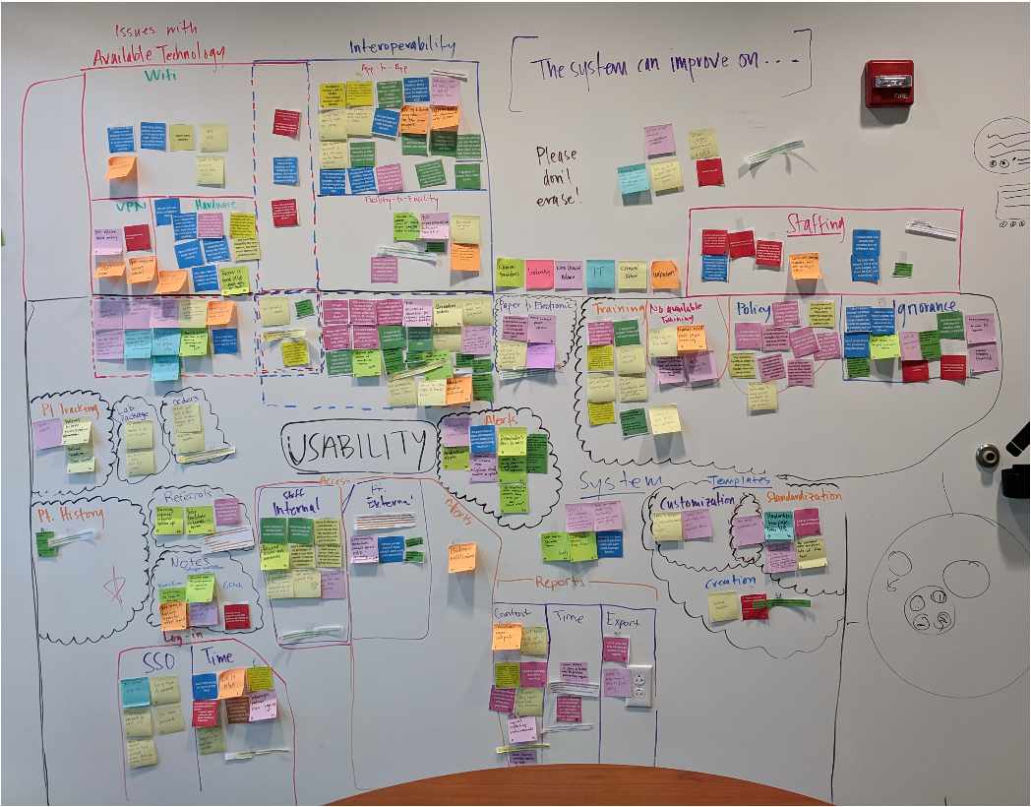
Methods - Analysis / Synthesis
Concrete descriptions from participants are extracted
Organized into categories and explored relationships to create a model of “what is”
Create an abstract model of what “could be”
Dubberly H, Evenson S, Robinson R. The Analysis- Synthesis Bridge Model. [Internet]. San Francisco (CA): Dubberly Design Office; [2008 Mar 1, cited 2019 July 7].

Slide 26
Thank you!
Email me at: jeshiver@regenstrief.org

Slide 27
HCD Tooling, Process, and Findings
HCD and HIT Modernization: Engagement of End Users in Health IT Modernization through Human-Centered Design
S28
Joseph Amlung
Regenstrief Institute
Twitter: #AMIA2019

Slide 28
Disclosure
I and my spouse/partner have no relevant relationships with commercial interests to disclose.

Slide 29
Learning Objectives
After participating in this session the learner should be better able to:
Assess tool’s appropriate fit for a specific Human-Centered Design (HCD) research project
Apply Human-Centered Design methods and tools to real-world settings
Iterate on Human-Centered Design methods to meet the needs of the project
Analyze findings after employing Human-Centered Design methods

Slide 30
Practical Considerations with IHS Project
The Human-Centered Design (HCD) work on the HIT Modernization Project needs to be:
Iterative - Conducted analysis continuously, not just at end of project
Deep - Examined not just what people said, but why they said it
Comprehensive - Studied data from all site visits and other available qualitative data sources, e.g. survey results
Intentional - Utilizes a process and a tool that fits the research goals, the data collection method, and the team members
Notes:
Deep - Figure out what they actually want, and look at environmental factors to see what may have influenced participant thoughts.
Overall - We needed to be fast, and we needed to respond to data requests often. Data analysis needed to be agile, yet thorough.

Slide 31
Iteration of HCD Methods
HCD methods should be evaluated and modified to better achieve research goals using the available time/resources.
IHS Project: Three rounds of iteration - Foundational, yet dynamic
 | Data Collection | Data Organization | Data Recording
1 | Participant thoughts on sticky and written notes; minimal team training | Two team members built hierarchy of themes using manually organized notes | All notes typed into Excel template by one person
2 | Same as above with more formal team training | Automatically import all notes into collaborative electronic “whiteboard” for organization | Attempted to train team members to use Excel template (unsuccessfully)
3 | Same as above | Team organization sessions conducted on-site with collected data. Deeper analyses conducted at home base. | Captured notes in user-friendly data recording tool following site visit
Ideo.org. Methods [Internet]. Design Kit. Available from: http://www.designkit.org/methods
Notes:
Foundational because the research goals did not really change, but dynamic because our methods changed to fit our needs and the population we worked with. This project was fast fast fast. Lots to do in a short time, with limited resources, and with geographically dispersed team, but we did not want to compromise integrity of findings. That’s why our methods had to change.
First round - “Pilot”: Minimal planning for data recording, analysis, and synthesis. Very short turnaround between initial planning and first site visit. Analysis was very thorough, but inefficient. Most planning was placed on collecting data, but a lot of time was required for recording or analyzing it.
Second round - “Evolved”: Evolve the previous methods based on debrief of first visits, leverage other team members to distribute tasks and improve efficiency. These methods were both thorough and relatively efficient, but it was hard to train team members on, and the benefit was not worth it.
Third round - “Team-friendly and Efficient”: Refine the Evolved methods to work efficiently for all team members. Played on team strengths and weaknesses.

Slide 32
HCD Tool Selection
Selecting a tool:
Think about the project goals, methods, and resources. Have a research process in mind.
Determine selection criteria and potential tools to use.
Evaluate tools using selection criteria, and have your team try them out, if possible.
Select tool(s) that will work best to achieve the desired outcome(s).
Criteria for this project:
Data Entry / Import
Ease of Use for Team
Price
Met Reporting Needs
Notes:
Tool refers to software or other resource that links HCD-related data to the analysis and synthesis stages of the work. It allows the team to digest HCD data to start forming conclusions and solutions.
1. Know how you’re going to get data and what it eventually needs to lead to. Know what is important for your project.
3. How will the users receive the tool? If they’re going to be the ones to use it, have them test it out, or you may find yourself in my position. I developed a process and Excel tool that worked for me, but not for the rest of the team.
4. This requires thinking through the whole process. What questions will you need to answer by the end of the project? Can the tool help you answer those?
Data Entry/Import - Our project had qualitative data coming in from site visits, surveys, web-based meetings, etc. Can the data be adapted from multiple sources?
Ease of Use - Once the data is in the tool, can various team members be included when using it?
Met Reporting Needs - Have an idea of what questions people are going to ask that your data can answer. What is the expected end product? How often will there be data requests?

Slide 33
Example: Tool Selection
Tool / Team Requirements | Data Entry / Import | Ease of Use for Team | Price | Met Reporting Needs
Tool 1
Tool 2
Tool 3
Tools considered in this project for analyzing qualitative data: Airtable, Dedoose, Atlas.ti, Excel
Notes:
Tools: Airtable, Dedoose, Atlas.ti, Excel
After considering tools and how well they would achieve our purposes, we selected Airtable as our tool to import, classify, and analyze our data.

Slide 34
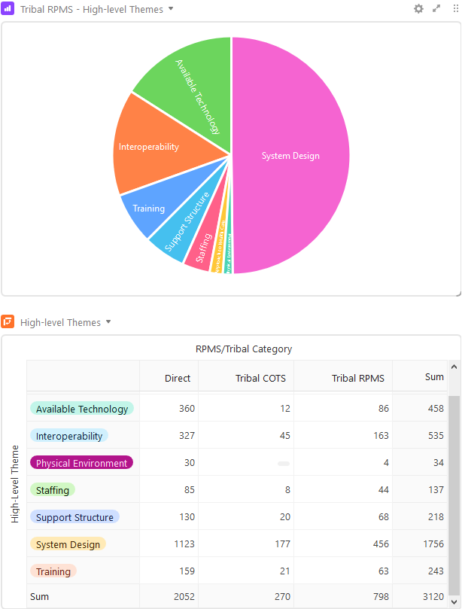
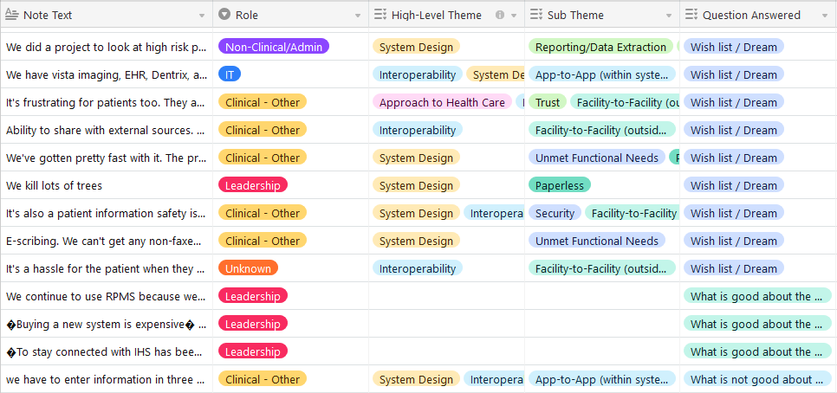
Analysis of HCD Data - Airtable
Notes:
In Airtable, notes collected on-site were classified with themes that we had previously developed. These “tags” allowed us to do analysis among all sites/groups that we spoke with, which helped us prioritize user needs and identify areas where we may need to ask additional questions. Airtable itself is pretty comparable to Excel, but it has key features like these tags that helped us achieve research goals easily. We can use this analysis to compile findings and start to gather up what resembles a story.

Slide 35
Current State Findings – User Perspective
Five high-level themes evolved from the insights collected from users at site visits, collected via listening sessions and interviews.
Minimal
Interoperability
“In this modern world there is absolutely no reason why an out of area tribal person can’t receive care from our facility. The record needs to revolve around the patient.”
“Our Clinical Application Coordinator (CAC) is great, but she’s just one person. We need at least three of her!”
Incomplete
System Design
& Disjointed
User Experience
Inadequate
Technology &
Connectivity
Limited Workforce
“The system is so slow, or providers/nurses get 'kicked' out of the system in the middle of a note.”
“[RPMS] has a high learning curve and takes several years to get to the point of identifying all that it can and cannot do. The written resources are not comprehensive and requires reaching out to other CACs or consultants.”
Inconsistent
Training & Support
“Our health system currently includes Medical, Pediatrics, Visiting Nurses, Hep C Treatment team, Mental Health, Chemical Dependency, Suboxone treatment, and Dental. RPMS cannot meet the demands of all of these separate services.”
Note: the diagram is scaled to reflect volume of comments for each theme
Notes:
Keep in mind that this is just a basic story that amalgamates what we heard on sites. However, there is a lot of room for further digging since every site is different. They have different needs and different populations to serve, so there can never be a single story that encapsulates them all.

Slide 36
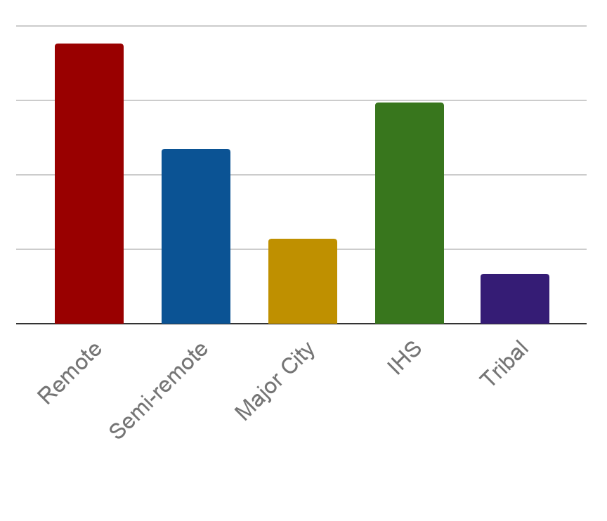
Example of Deeper Analysis
User Need: Asynchronous data collection and subsequent integration into the database.
“There’s a lot of manual tracking [in public health] that our admin staff have to do. I notice a lot our staff are still using paper and that’s very time consuming for them.”
“[We need] Portability - iPads/tablets"
User Comments
Comments Received
Site Remoteness
Facility Type
Notes:
Having a deeper understanding of as many users and processes as possible helps to move towards a design for HIT that meets end user needs.

Slide 37
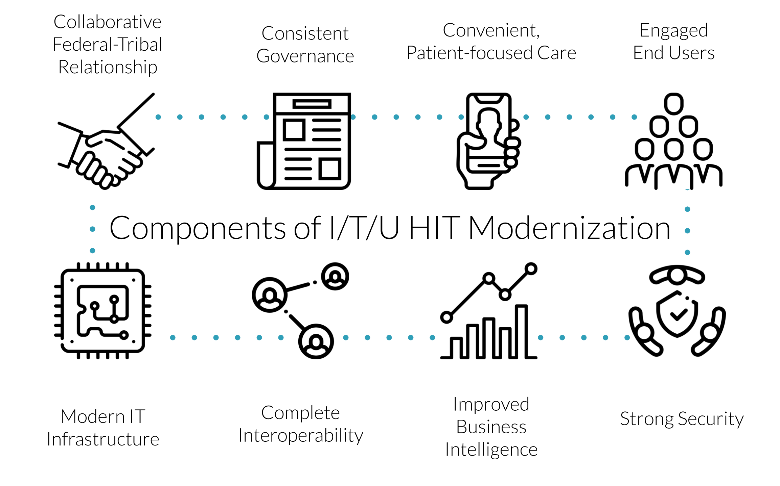
Future State HIT Vision
Revealed in Qualitative Data
Notes:
These are some of the suggested concepts that a future state of HIT should consist of, as determined by the entire HHS IHS HIT Modernization Project. Among these, the qualitative data we collected revealed most of them and added very informative stories, perspectives, and insights.
What I find incredible about this work and the Human-Centered Design method is that it allows the end users to own their HIT modernization effort. These recommendations aren’t from a board of executives; they are a synthesis of the voices of those who have their boots on the ground and provide healthcare in the Indian Health setting. Users cannot have an HIT solution thrust upon them, but instead, they must be what the HIT solution is designed around so that they can do their jobs in taking care of their patients.

Slide 38
Thank you!
Email me at: jamlung@regenstrief.org

Slide 39
HCD Challenges and Lessons Learned
HCD and HIT Modernization: Engagement of End Users in Health IT Modernization Through Human-Centered Design
S28
Sabrina Fonseca
&Partners
Twitter: #AMIA2019

Slide 40
Disclosure
I and my spouse/partner have no relevant relationships with commercial interests to disclose.

Slide 41
Challenges
Emerging themes looked consistent—what else could we learn?
Lack of in-depth vision for Health IT modernization—the dream state and north star
Lack of context around Health IT issues identified
What's unique: Differentiate healthcare for American Indian and Alaska Native communities vs. other healthcare systems
Notes:
After some site visits, and with many visits still to be done, the themes that emerged looked consistent—what else could we learn?
In qualitative research variety of findings is important, and quantitative analysis is done to ensure findings are statistically meaningful (which is how the data call information was used). This is the difference between qualitative and quantitative research. One looks for the WHY/HOW and the latter is about the WHAT.
Listening sessions and virtual focus sessions weren't eliciting in-depth responses to what Health IT modernization (the dream state) might look like
Creating a clear view of what Health IT modernization looks like for IHS required more context around the staff's workflows, how they interact with each other
Needed to outline what makes healthcare for American Indian and Alaska Native communities unique vs. other healthcare systems—and how that affects Health IT requirements
so that themes like interoperability aren't discussed as a novelty, but not overlooked either

Slide 42
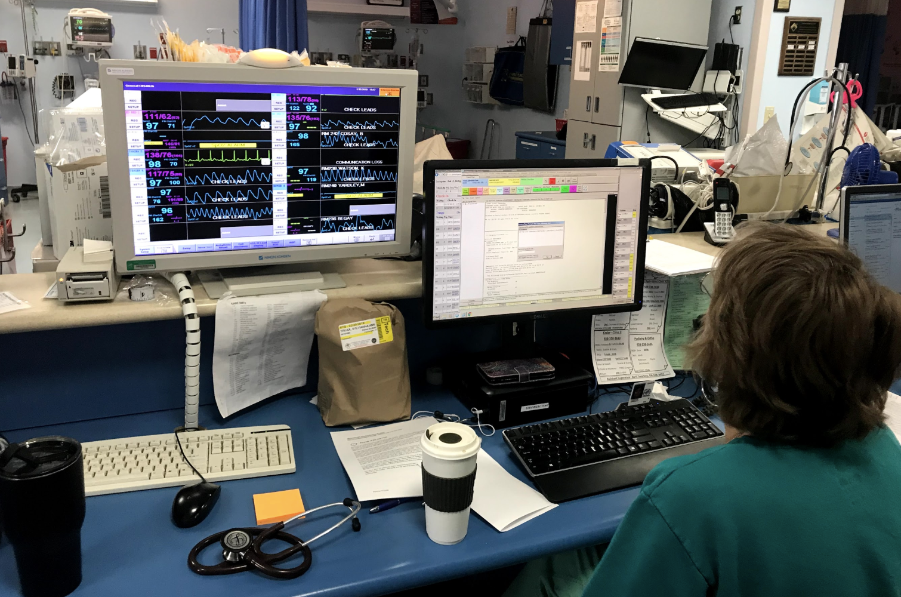
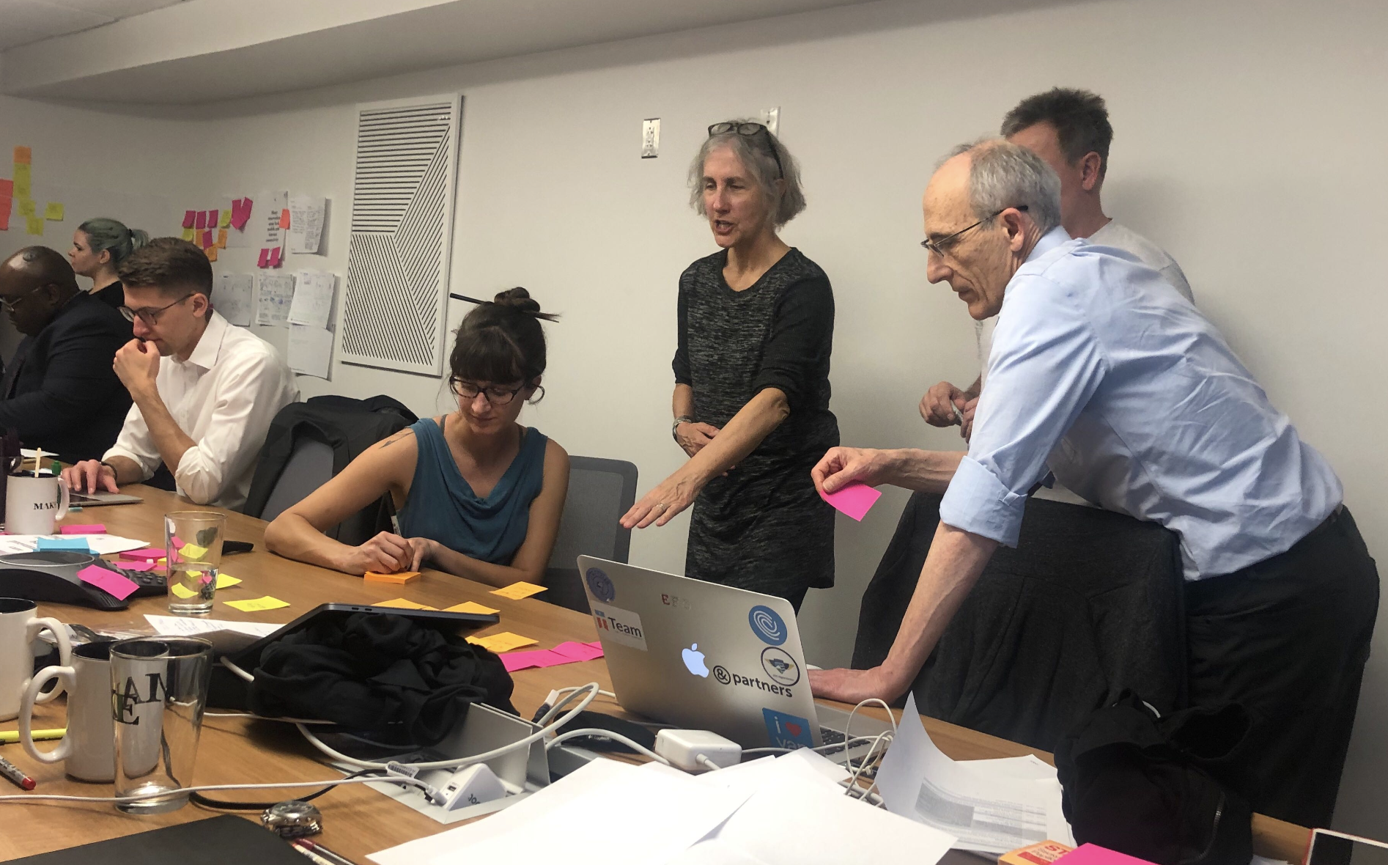
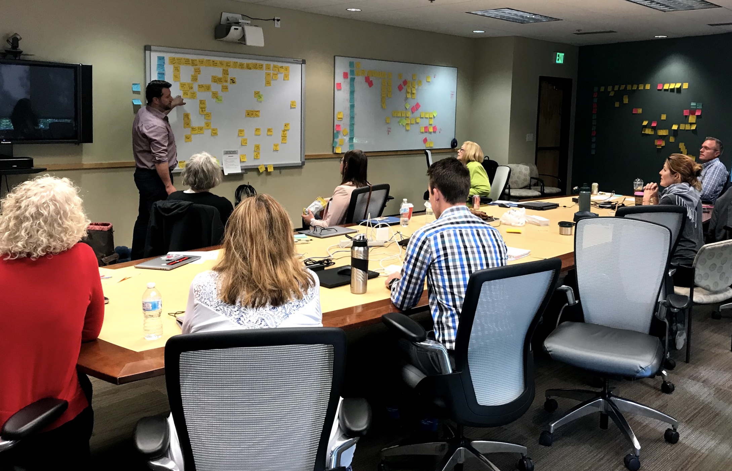
Reassessing HCD Methodologies
Added qualitative research methods for in-depth findings:
In-person and remote 1:1 interviews and workshops with 148 people
New focus: workflows and how staff interacts
25 hours of workshops with subject matter experts at IHS and NIHB (patient advocate group) to validate and further develop workflows
Fine-tuning existing methodologies
Notes:
Talking points 1:1 interviews:
Can ask more in-depth questions
More intimate with fewer participants and facilitators, users may open up more
Avoids including supervisors, which hinders staff's feedback
Added questions for 1:1 interviews and workshops:
Roles and who they interact with
Step-by-step workflow around specific common tasks and scenarios—and what parts of it are challenging
What's unique about working in this environment vs. other environments where you've worked before?
Fine-tuning existing methodologies:
Facilitating is hard: make facilitation and note-taking roles consistent
Create feedback loops to improve questions and facilitation technique

Slide 43
Reassessing HCD Methodologies
Deliverables added to final report, specific to defining the "North Star" for Health IT modernization:
Service Blueprints
Describe "happy path" scenarios of how Health IT modernization can improve services
Ecosystem: Profiles for IHS, Tribal, and Urban Facilities
Describe the variability of resources in each environment
Archetypes
Describe user groups based on Health IT needs
Use Cases
Extracted from service blueprints and archetype narratives, they provide a list of all requirements for Health IT modernization to help the IHS evaluate options

Slide 44
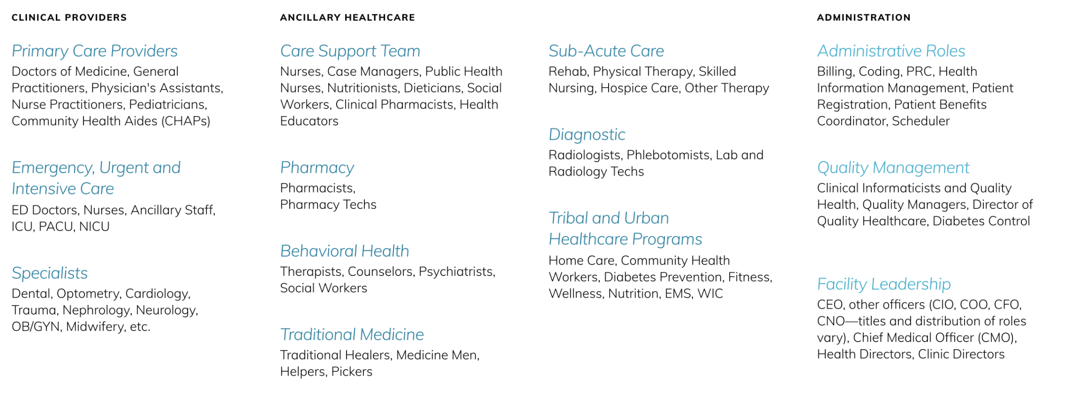
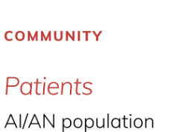
Notes:
Archetype groupings were defined based on common Health IT needs—if we were researching for different goals, say how to provide the best mental health experience to a patient across all disciplines, our groupings could have been widely different.

Slide 45
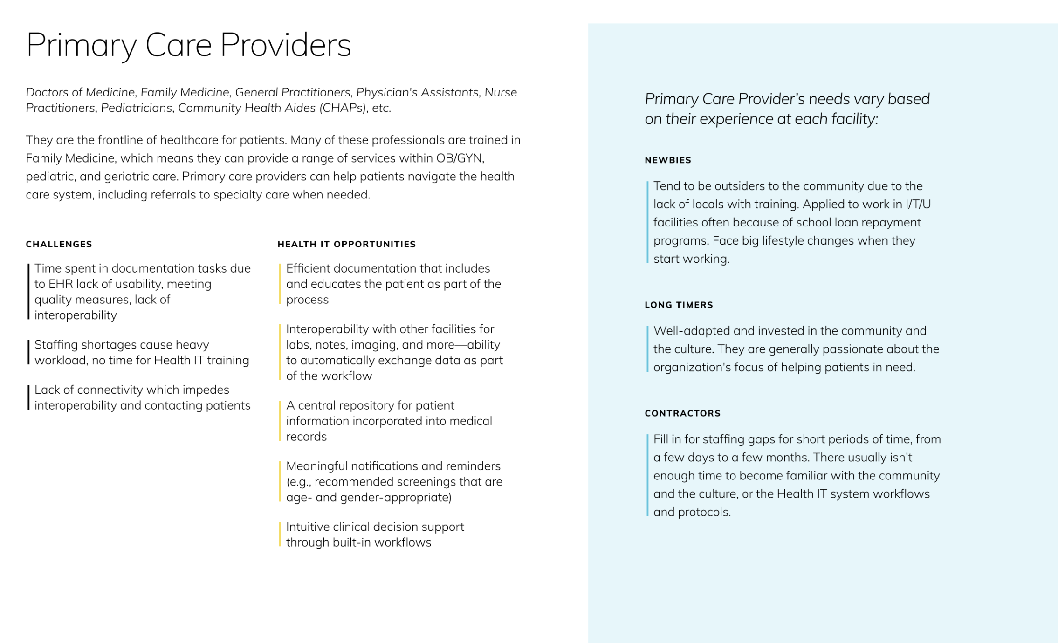

Slide 46
Service Blueprints
Starting from patient scenarios based on health disparities in AI/AN communities:
High-risk pregnancy
Guardianship of grandchildren
Suicide ideation
ATV Accident
Recovering from opioid addiction
Diabetes comorbidities
End-of-life care

Slide 47
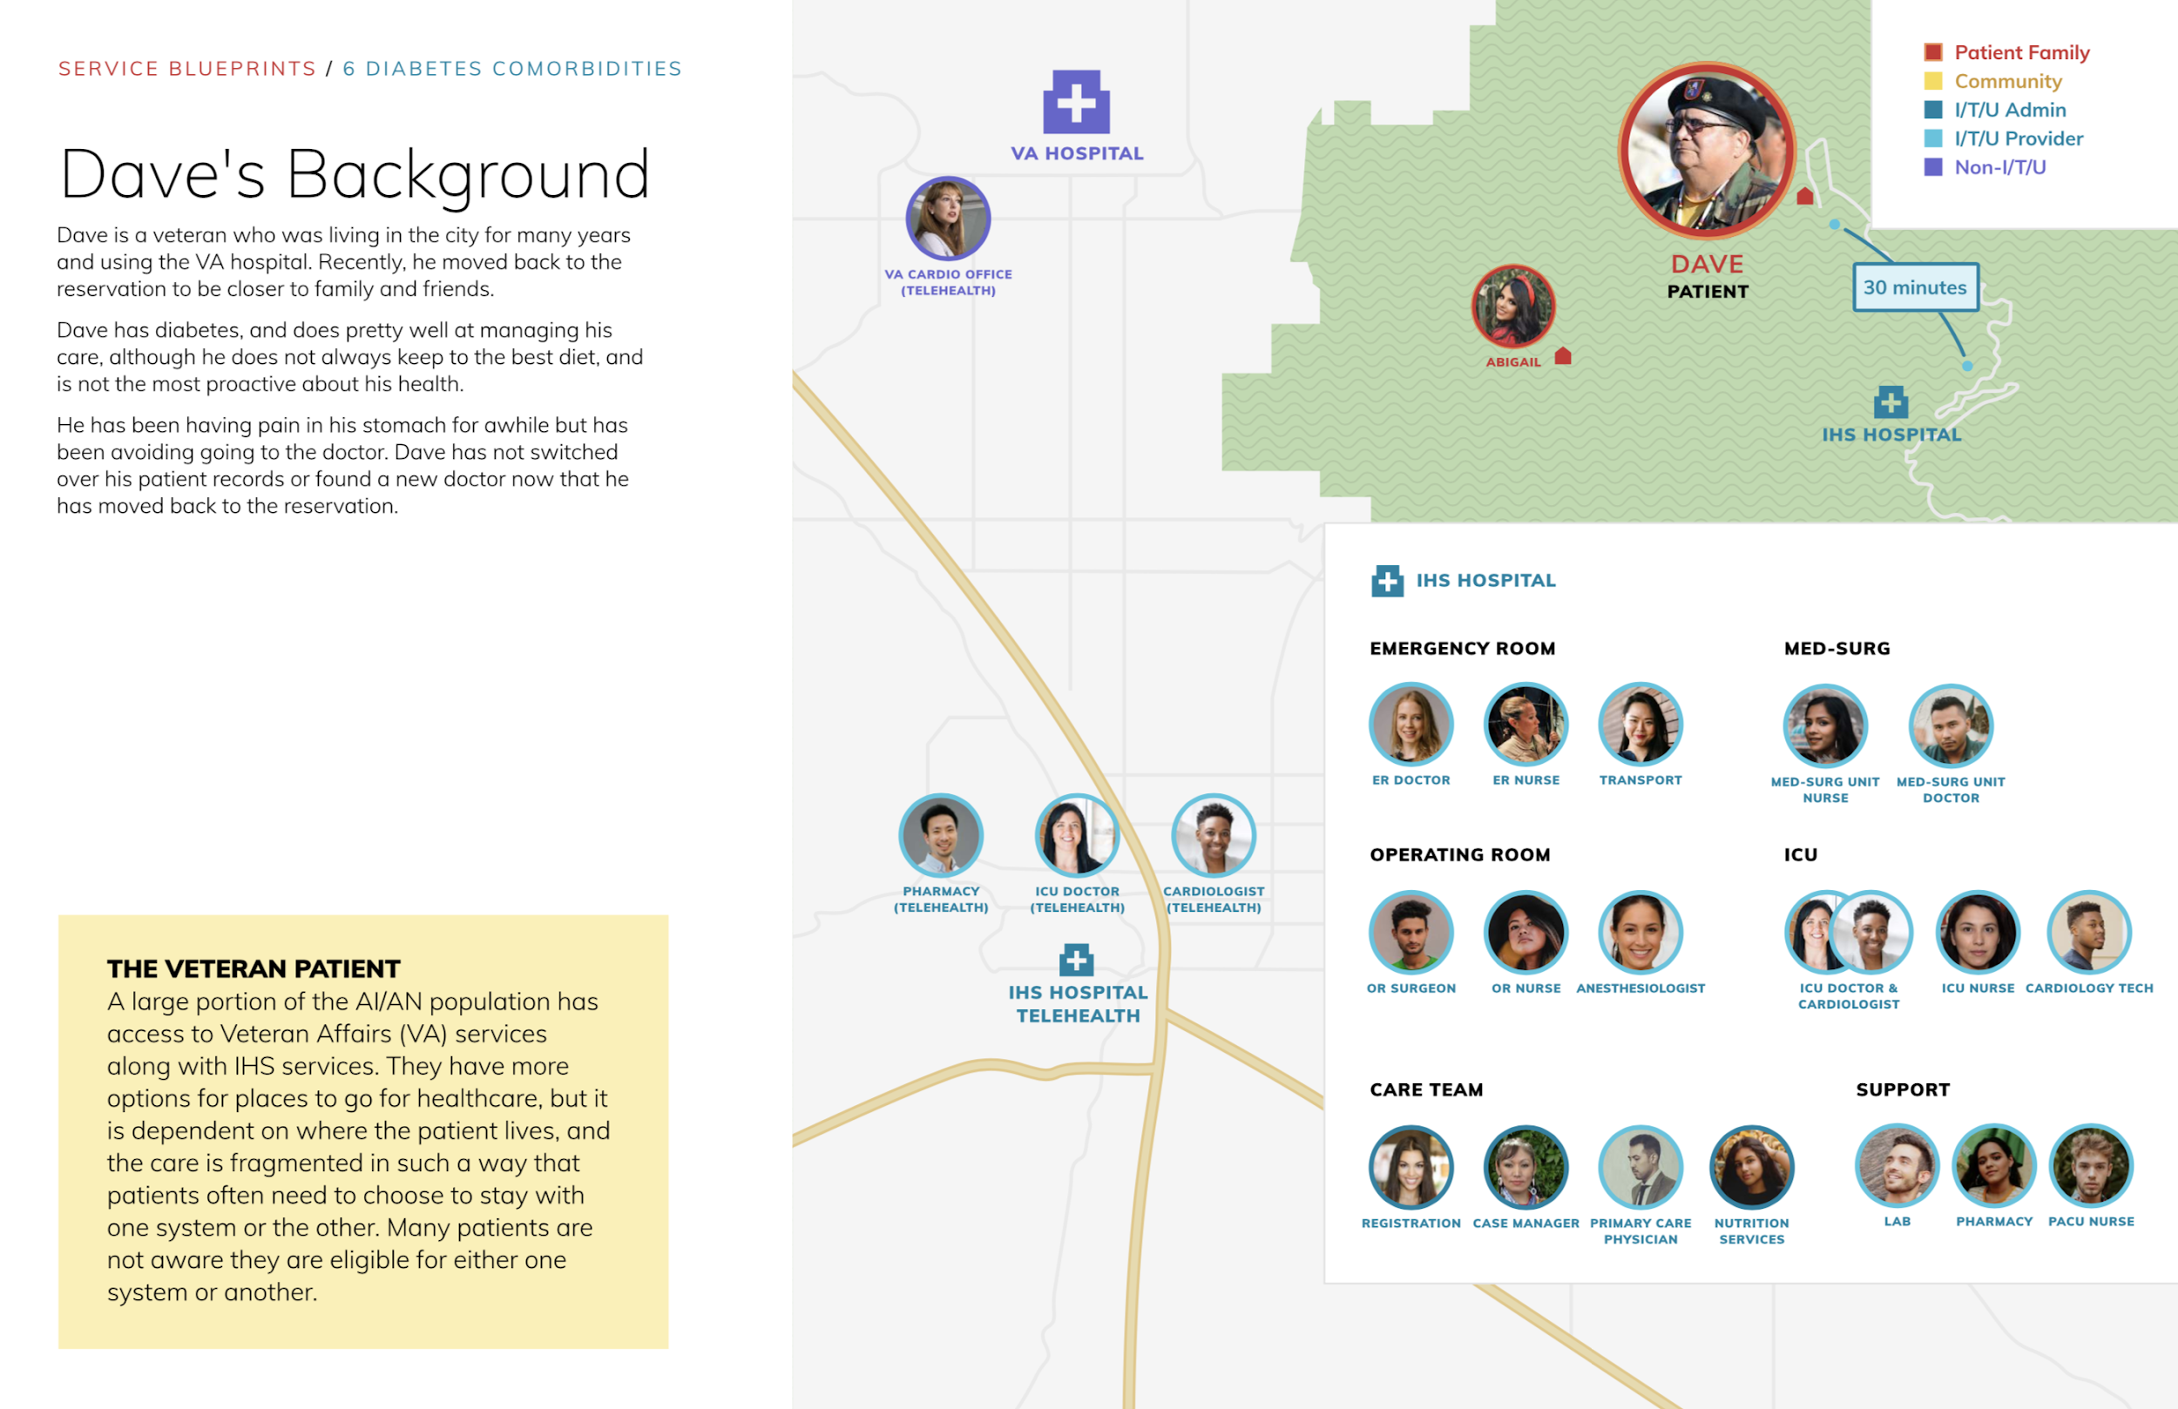

Slide 48
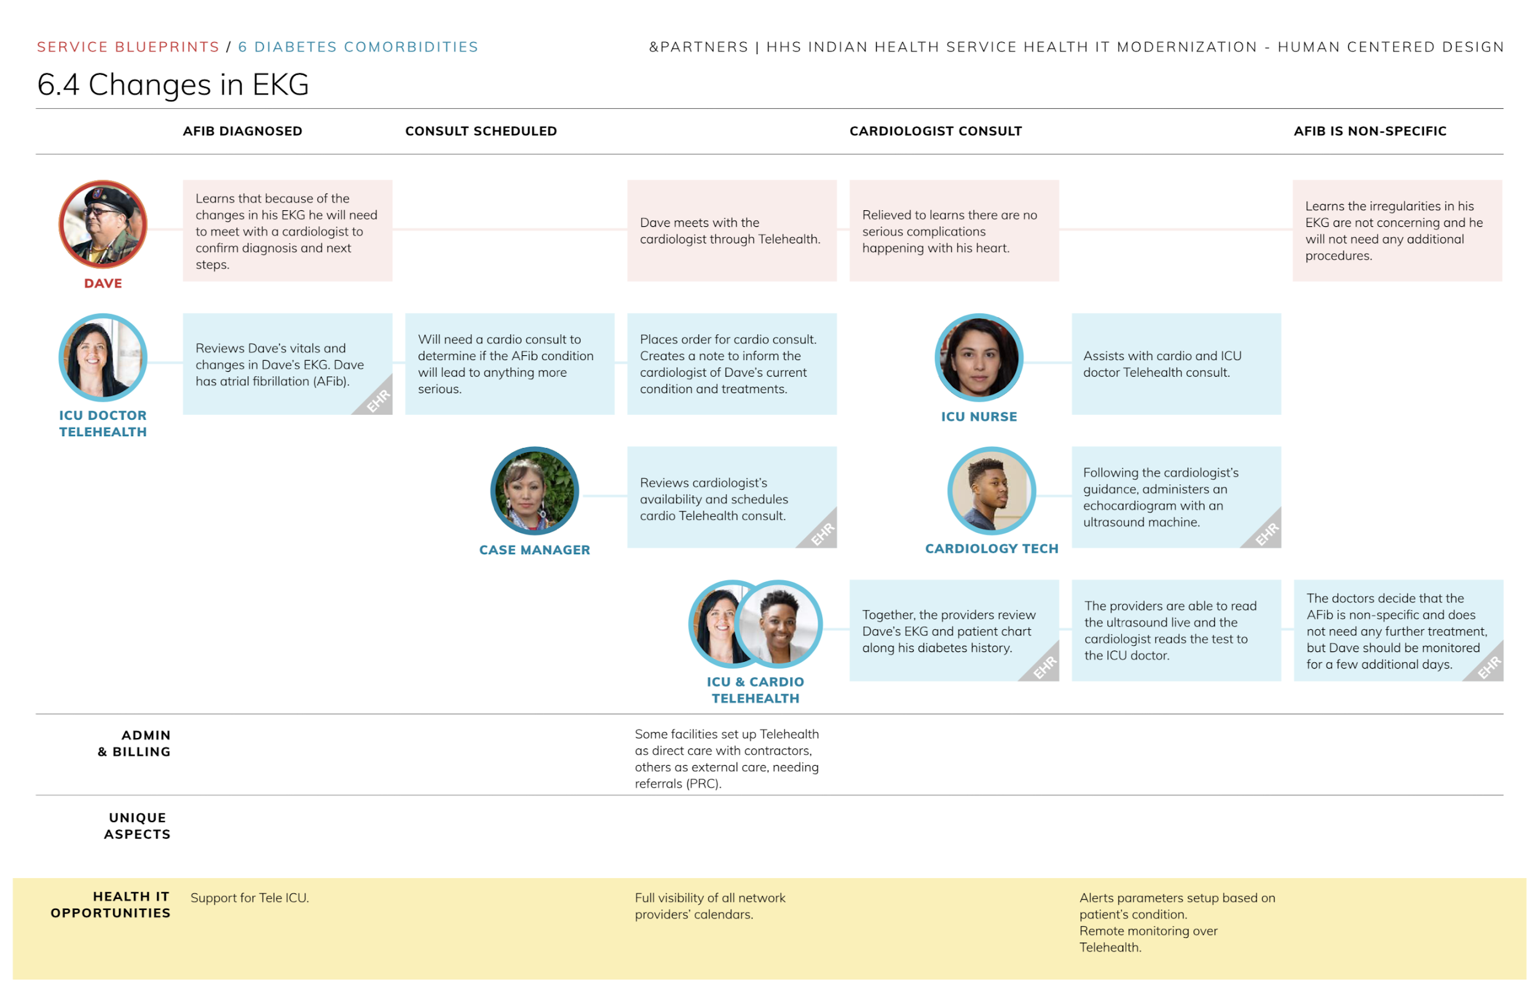

Slide 49
Use Cases
As a _______,
I want to _______,
so I can _______.

Slide 50
Use Cases
As a primary care provider,
I want to enter notes asynchronously,
so I can work on EHR when there's no internet connection.

Slide 51
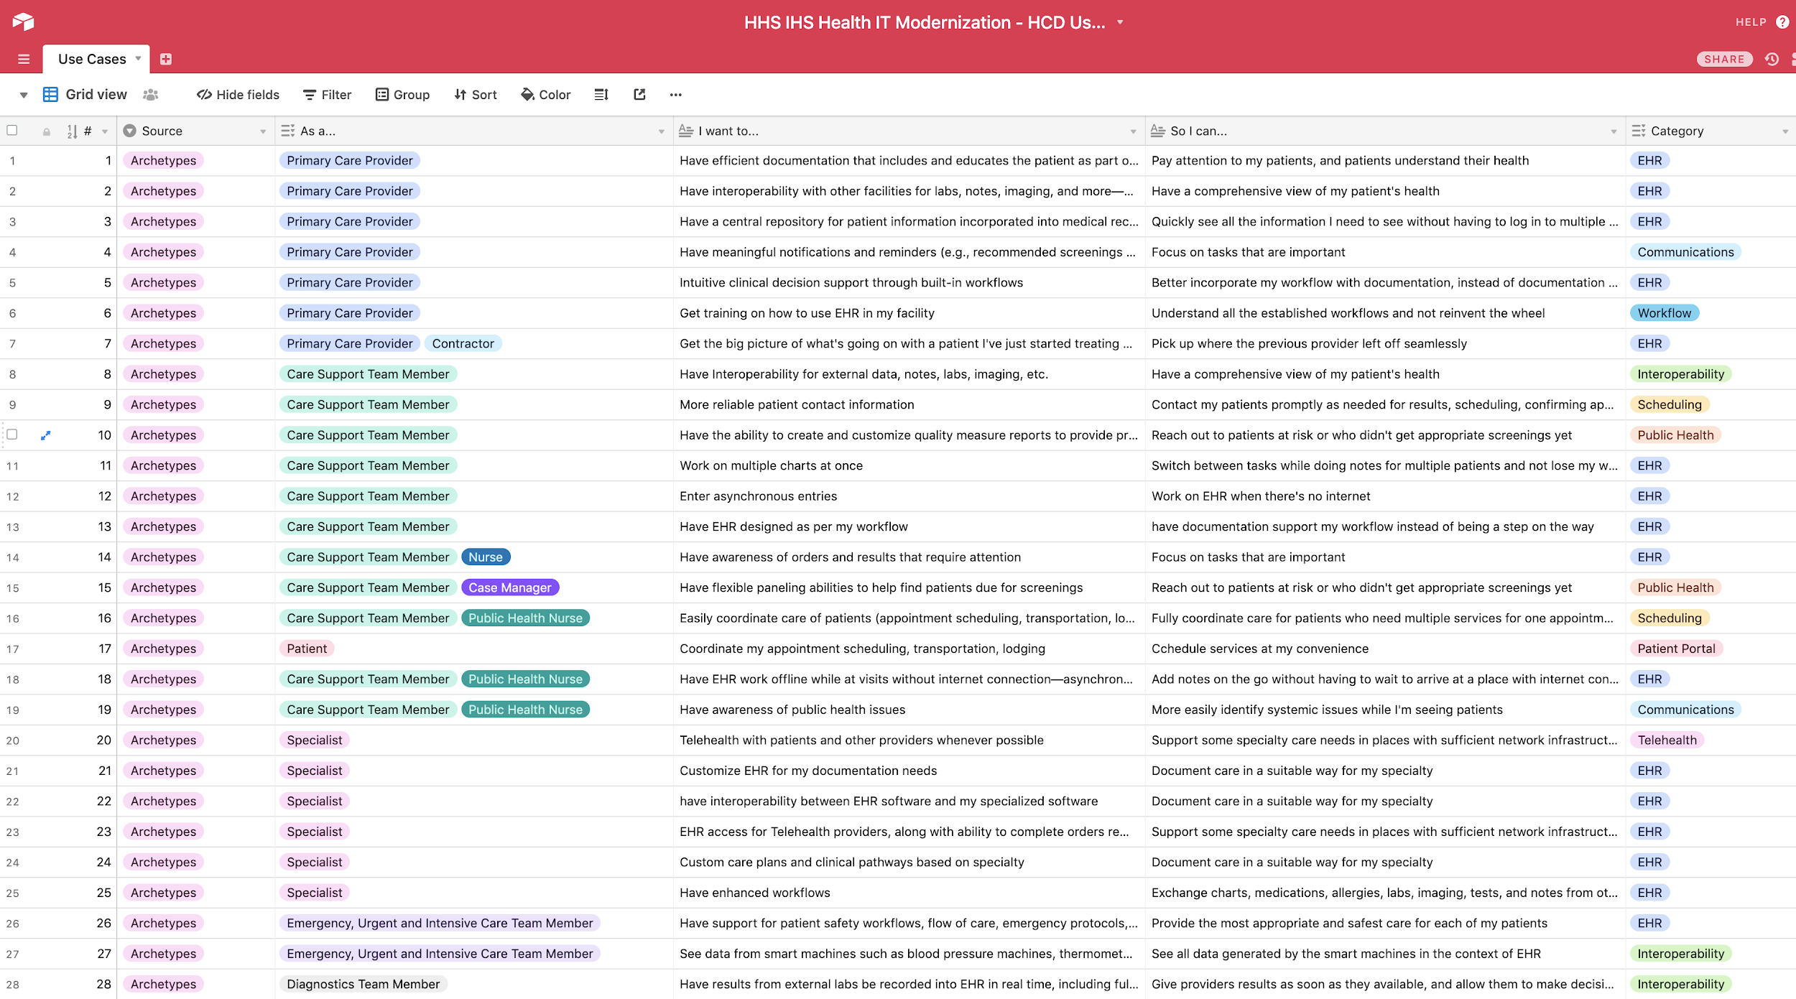
Notes:
240+ tagged use cases, can be sorted by category, user type and source.
On airtable, also used for analysis of interviews.

Slide 52
Lessons Learned
Qualitative research: make sure you are always learning something new until you stop learning
Evolving research methods as you go is okay in qualitative research
Consider how you will manage data collected when designing research
Avoid collecting data without having a sense of how it will be used
Be intentional about perfecting your methodology
Create touch points with others to improve questions, methodologies, facilitation technique
Adapt for remote teams
Create periodic remote touch points over audio/video conferencing: stand-ups, kickoffs
Make sure team has (some) common working hours if distributed across time zones
Create and take advantage of opportunities for in-person collaboration

Slide 53
Dig in
HHS IHS Health IT Modernization Human Centered Design Report: Archetypes, ecosystem, service blueprints, use cases: http://bit.ly/HCD-IHS
Use cases extracted from archetypes and service blueprints: http://bit.ly/IHS-HCD-usecases

Slide 54
Thank you!
Email me at: sabrina@andpartners.io

Slide 55
Questions / Discussion Questions
What are the benefits and challenges of using HCD methods in health informatics projects?
What was the process of learning how to incorporate HCD methods into a health informatics project?
What are the benefits, barriers and challenges of using HCD methods and research practices for more than application interface design?
How can barriers to using human-centered research approaches be reduced or removed?
What tooling or strategies can be used to increase the success of HCD?
What are some approaches for removing barriers for teams that are not co-located, yet want to analyze and synthesize together?
What are some of the challenges in researching and designing for complex systems including multiple user types performing complex team activities?

Slide 56
Question 1
HCD, human centered design, has been successfully used in the later stages of design research processes to design interfaces/processes and evaluate their usability for health IT. What is the value of using an HCD approach earlier in the design research process?
There is no value until you are actually creating an interface/process or evaluating usability.
HCD can be easily implemented with little end user involvement.
HCD facilitates stakeholder buy-in and allows the researcher to begin to develop empathy for the different users and their perspectives and needs.
HCD allows for skipping the planning and learning stages of design research process and going straight to the developing and testing phases.

Slide 57
Answer 1
There is no value until you are actually creating an interface/process or evaluating usability.
HCD can be easily implemented with little end user involvement.
HCD facilitates stakeholder buy-in and allows the researcher to begin to develop empathy for the different users and their perspectives and needs.
HCD allows for skipping the planning and learning stages of design research process and going straight to the developing and testing phases.
Using HCD early in the project lifecycle facilitates buy-in as stakeholders and end users are engaged and have some voice in shaping the definitions of the problem. In addition, researchers are able to learn more about the needs and challenges of the stakeholders and will be more able to empathize with stakeholder viewpoints on the challenge.
Saleem JJ, Plew WR, Speir RC, Herout J, Wilck NR, Ryan DM, Cullen TA, Scott JM, Beene MS, Phillips T. Understanding barriers and facilitators to the use of Clinical Information Systems for intensive care units and Anesthesia Record Keeping: a rapid ethnography. International journal of medical informatics. 2015 Jul 1;84(7):500-11. Available from: https://www.sciencedirect.com/science/article/pii/S1386505615000660?via%3Dihub

Slide 58
Question 2
Some people on your research team have limited experience with HCD and HCD methods. What are some key things that you need to tell them to do to successfully capture good information? All of the following except:
Share your opinions and experiences with the participants
Make sure that participants feel safe to participate.
Don’t use leading questions
Capture thoughts in the participant's own words

Slide 59
Answer 2
Share your opinions and experiences with the participants
Make sure that participants feel safe to participate.
Don’t use leading questions
Capture thoughts in the participant's own words
Research facilitators should be aware of their own biases and experiences and make sure NOT to inject their opinion or experience into the findings from participants. The goal should be to capture participant information.
When facilitating, it is important to make sure that participants feel safe in sharing their experience. Depending upon the research, you may need to make sure that their management is not in the room.
Leading questions introduce bias. Be careful and try to use prompts like, “tell me more about that.”
Capturing the thoughts in the participants words will help in capturing their nuanced perspective.
The U.S Digital Service. Washington (DC): United States Digital Service; 2014 Sep 15. Digital services playbook; 2014 Sep 15 [cited 2019 Mar 12]; [about 27 screens]. Available from: https://playbook.cio.gov/

Slide 60
Question 3
How do you determine methods for your HCD project?
You need to consider the context, including the culture, environment, goals, tools, and resources available. Then you would tailor the method to meet your individual research needs.
There are numerous methods textbooks and internet resources. You can pick one and use it.
Use the same method as a previous project that your team is familiar with.
Just try something and hope it works.

Slide 61
Answer
You need to consider the context, including the culture, environment, goals, tools, and resources available. Then you would tailor the method to meet your individual research needs.
There are numerous methods textbooks and internet resources. You can pick one and use it.
Use the same method as a previous project that your team is familiar with.
Just try something and hope it works.
HCD can manifest in a variety of methods, so it is important to think about the research needs and find the best method for that. While previous projects, textbooks, or internet resources may have good ideas, they might not be exactly what is best for your project.
New ways to engage with patients [Internet]. Washington (DC): American Hospital Association; 2018 May 24 [cited 2019 Mar 12]. Available from: http://www.healthforum.com/connect/resources/insights-vol5-i1-feature-osf-human-centered-design.shtml

Slide 62
Question 4
You conducted some initial data gathering sessions, and now you have a clearer picture of the knowledge you want to gain from your participants. Your next step is to:
Keep the method the same. It is important for data collection continuity.
Review the method(s) and optimize, adjust the method, or add an additional method.
Stop collecting data and start analysis immediately.
Start prototyping a new solution with the knowledge you just learned.

Slide 63
Answer 4
Keep the method the same. It is important for data collection continuity.
Review the method(s) and optimize, adjust the method, or add an additional method.
Stop collecting data and start analysis immediately.
Start prototyping a new solution with the knowledge you just learned.
When using HCD methods at the beginning of a research project, it is important to begin with broad questions that help the research team identify areas of interest or challenges from the participant’s perspective. As these areas are identified, it is good to begin to focus the research methods to understand more about areas of interest or concern for the participants.
Ideo.org. Methods [Internet]. Design Kit. Available from: http://www.designkit.org/methods

Slide 64
Question 5
You have a geographically dispersed team and you want to do analysis together. How might you approach analyzing all of your data together? All of the following except:
Schedule time while the team is gathering data to do initial analysis together.
Use electronic tools to try to bridge the gap.
One person analyzes all the data.
Micromanage all team members to ensure they do not incorrectly analyze data.

Slide 65
Answer
Schedule time while the team is gathering data to do initial analysis together.
Use electronic tools to try to bridge the gap.
One person analyzes all the data.
Micromanage all team members to ensure they do not incorrectly analyze data.
There are a variety of ways to work through the challenge of not being co-located. When possible, take advantage of the time that the team members can spend together, but also embrace technology or other strategies for accomplishing data analysis.
IDSA, Industrial Designers Society of America [Internet]. Washington (DC): newtarget; 1996 Dec 6. Kolko, J. Information architecture and design strategy: the importance of synthesis during the process of design. New York: ISDA; 2017 Dec 1 [cited 2019 Mar 12]; [8 screens]. Available from: http://www.idsa.org/sites/default/files/Kolko-InfoArchDesignStrategy.pdf

Slide 66
Question 6
When selecting tools to support your research processes, all of the following are key considerations except:
Usability and agility of the tools for data entry
Ability of the tools to analyze data and meet end goals
Marketing videos on the tool’s webpage
The data collection method utilized in the research

Slide 67
Answer
Usability and agility of the tools for data entry
Ability of the tools to analyze data and meet end goals
Marketing videos on the tool’s webpage
The data collection method utilized in the research
While marketing and demonstration videos can be helpful to show what the tool can do, it is most important that the selected tool adequately fits the research goals.
18F [Internet]. Washington (DC): 18F, General Services Administration; 2105 Nov 24. 18F Methods. Decide. Elaborate on research from your discovery phase; 2016 Dec 15 [cited 2019 Mar 12]; [1 screen]. Available from: https://methods.18f.gov/decide/affinity-diagramming/

